Slide 1
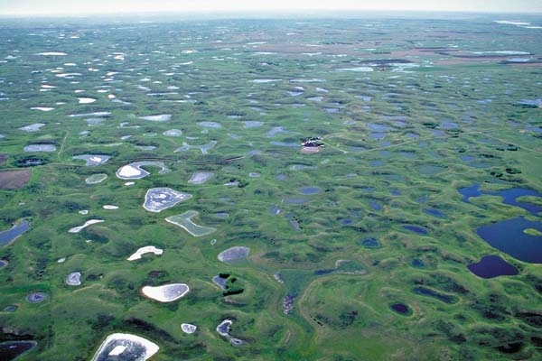
Niches, Neutrality and the Metacommunity

Slide 2






















Organism/individual
Fitness
Behavior
Physiology
Etcetera
Population/ Metapopulation
Abundance
Growth/dynamics
Distribution
Community/Metacommunity
Coexistence/Assembly
Richness/diversity/Evenness
Scale and Beta-Diversity
Change through time (stability)
Food Webs and trophic structure (also mutualisms)
Biodiversity and ecosystem functioning (BEF)
Ecosystem fluxes and cycles
Time
Energy, Nutrients, water
Energy, Nutrients, water

Slide 3
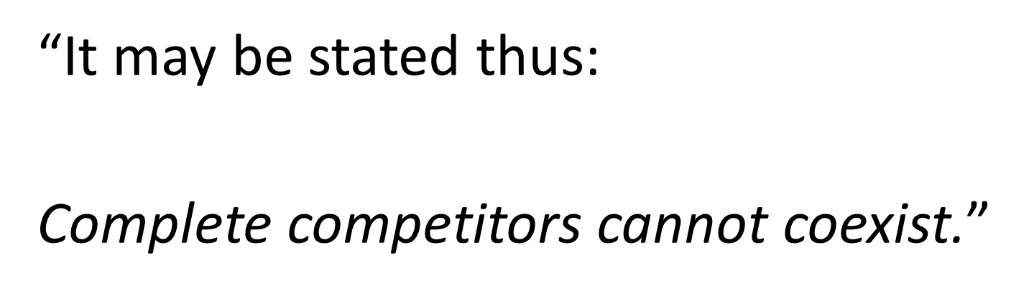
Gause 1934
Hardin G (1960) The competitive exclusion principle. Science 131:1292-1297

Slide 4
The R* Principle
A
Growth rate dN/Ndt
B
R*_{B}
R*_{A}
[R]
Two species together…the species with the lowest R* always wins
….when there is only one limiting resource, and the system is at equilibrium
…But, then how do species coexist??

Slide 5
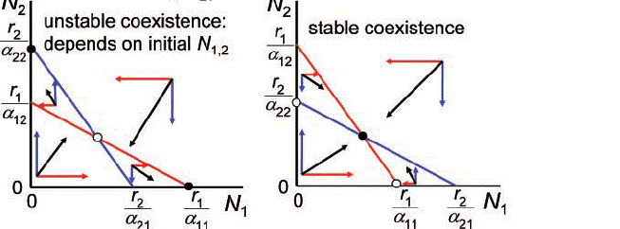
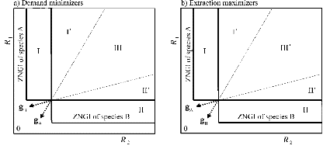
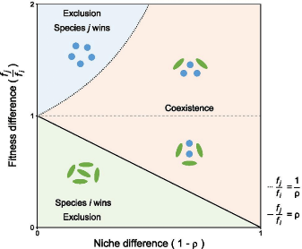
Lotka-Volerra
Consumer-Resource/Niche
Modern Coexistence Theory (MCT)
Coexistence:
Intraspecific effects > Interspecific Effects
Priority effects:
Intraspecific effects < Interspecific Effects
Neutral:
Intraspecific effects = Interspecific Effects

Slide 6
Species can’t be too similar……
….but, they also can’t be too different
Chesson’s (2000) Modern Coexistence Theory (MCT)
Coexistence depends on the ratios of:
→Stabilizing Mechanisms (Can’t be too similar)
-Niche differences
→Equalizing Mechanisms (Can’t be too different) -Fitness differences (neutral)
Possible Coexistence
Possible Coexistence
Resource A
Resource B
Adler et al. 2007, A Niche for Neutrality. Ecology Letters

Slide 7


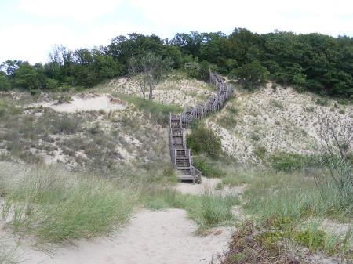
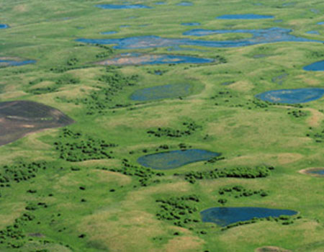

Just How Predictable are Communities?
… Cooper, Egler, others
…Clements, others

Slide 8
A Debate that has Spanned the Ages:
1920’s-1930’s
Superorganismic versus Individualistic Succession
(Cowles, Clements vs. Cooper, Gleason)
1940-1960’s Competitive exclusion versus Randomness
(Hutchinson, Elton, Lack vs. Diver, Riley)
1970’s-1980’s
Assembly Rules versus Null Models
(Diamond vs. Simberloff)
1980’s-1990’s
Lottery Models versus Coexistence
(Sale vs. Chesson)
2000-2010’s
Niche versus Neutral

Slide 9

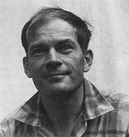

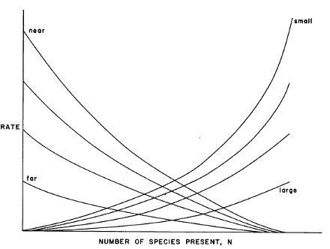
MacArthur’s Paradox:
An Early, but Incomplete, Synthesis
Deterministic (niche)
Stochastic (neutral)
Resource Ratio Model:
Basis for Niche Theory
Theory of Island Biogeography:
Basis for Neutral Theory

Slide 10
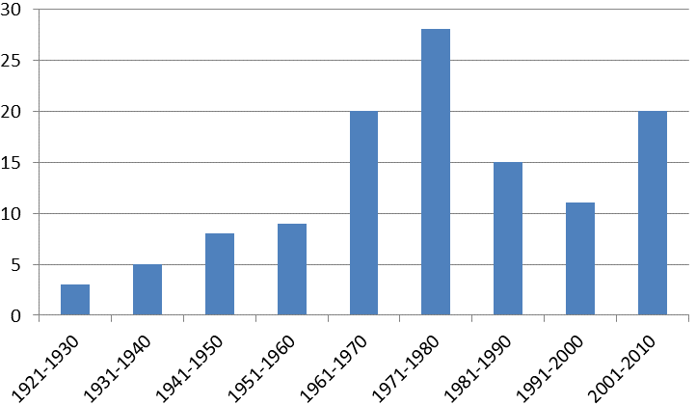
‘Ecological Niche’ concept through time
Hutchinson
MacArthur
Percentage of papers
Grinnell
Elton
Percentage of papers in Ecology using ‘niche’

Slide 11
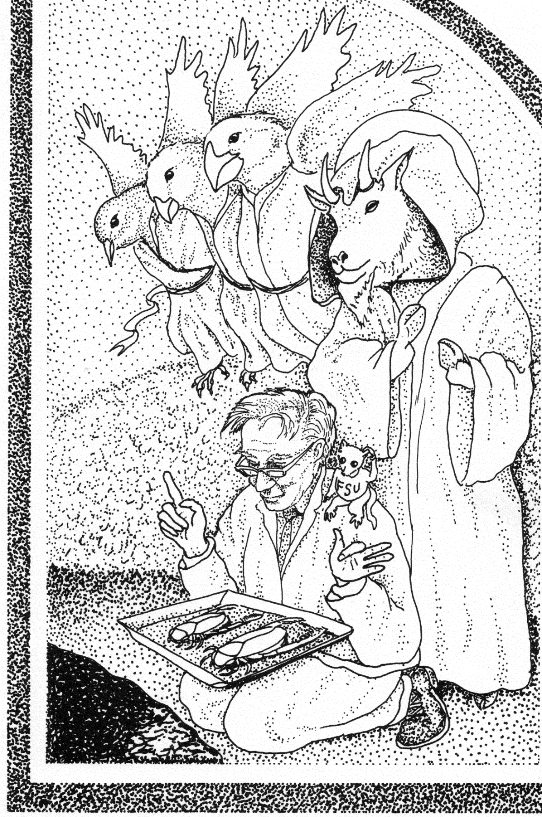

Anti-Thesis…

Slide 12


‘Ecological Niche’ concept through time
Simberloff, Strong et al.
??
Hutchinson
MacArthur
Thesis v. 2
Anti-Thesis
v. 2
Percentage of papers
Grinnell
Elton
Percentage of papers in Ecology using ‘niche’

Slide 13
Unified Neutral Theory:
Are species everywhere they could be?
What regulates species commonness and rarity?
Are communities stable or ever-changing through time?
The ‘Neutral Theory’ provided an alternative framework to more traditional ‘Niche Theory’ that appeared to predict a number of commonly observed patterns in nature

Slide 14
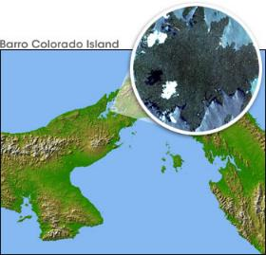
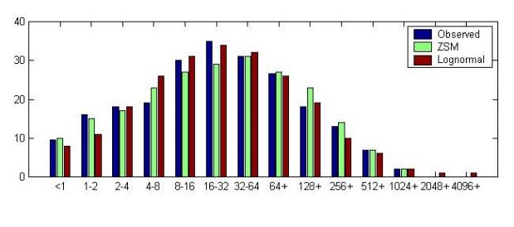
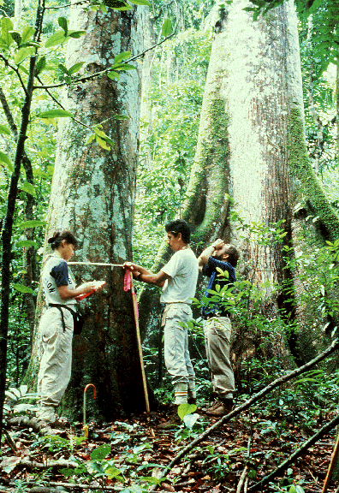
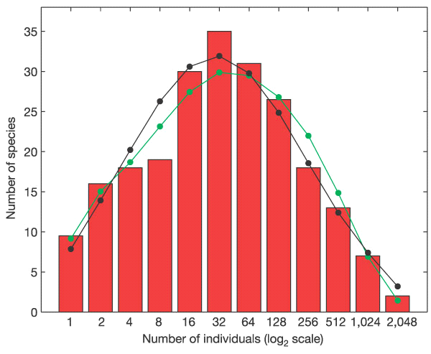
Tests with Species Abundance Distributions (SADs)
Initial tests of neutral theory
50 ha on Barro Colorado Island
McGill 2003, Nature
ZSM
Lognormal
Volkov et al. 2004, Nature

Slide 15





Niche vs. Neutral—what’s the evidence?
Somewhere in the middle
(Synthesis v.1)
Pure Neutral
Pure Niche
Early 2000s
2005-2010
2010-2015
Today

Slide 16
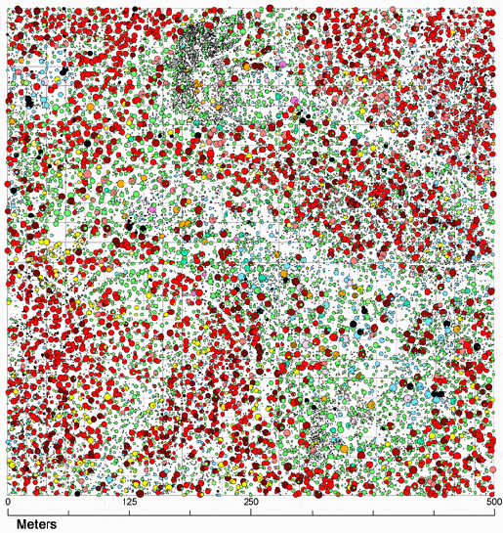
What influences spatial aggregation? How do we quantify it?

Slide 17
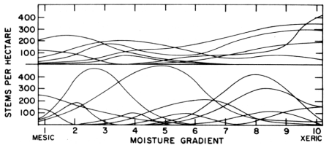
Whittaker’s concept of β-diversity
Low β-diversity
Siskiyou Mountains, Oregon
Santa Catalina Mountains, Arizona
High β-diversity
A deterministic “niche-based” perspective

Slide 18
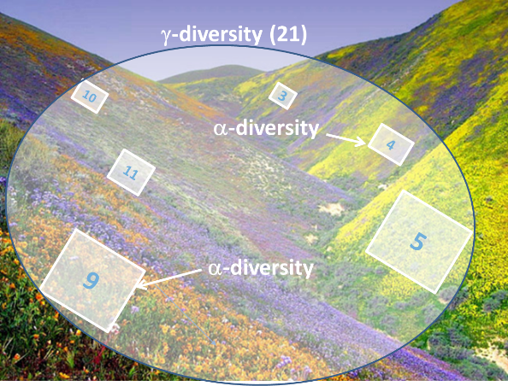
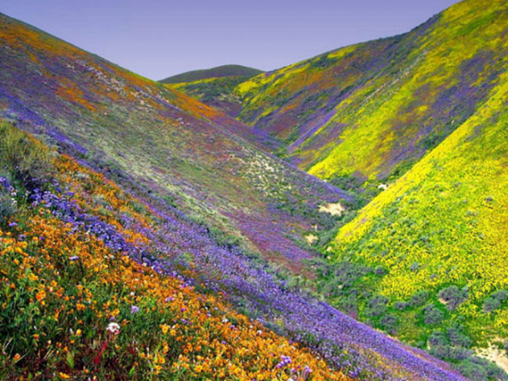
..There is a long history of trying to quantify β-diversity
α β = γ
β = γ/α
γ-diversity (21)
10
3
α-diversity
= 21 / 7
= 3
4
11
5
9
α-diversity
β-diversity is a scalar from local (α) to regional (γ)

Slide 19
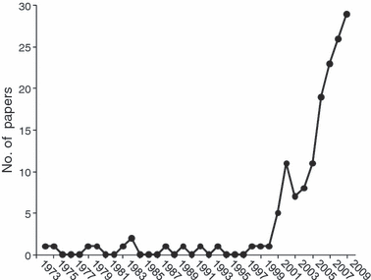
The β-diversity concept through time
‘5000 +citations’
’10,000 + citations’
Anderson, Crist, Chase, et al. 2011 Ecology Letters

Slide 20
Using β-diversity to Disentangle Niche vs. Drift/Dispersal Limitation
Regional Species
Pool
β-
diversity
Species Sorting
(Niche)
A B C D
A B C D E
F G H I J
D E F G
G H I J
Regional Species
Pool
β-
diversity
A B C D
A B C D E
F G H I J
Stochastic assembly
(Drift)
D E F G
G H I J

Slide 21
Space vs. environment: What can β-diversity tell us?
Neutral Model
Niche Model
Beta-diversity
Beta-diversity
Spatial gradient
Spatial gradient
Environmental gradient
Environmental gradient
Chase et al. 2005

Slide 22
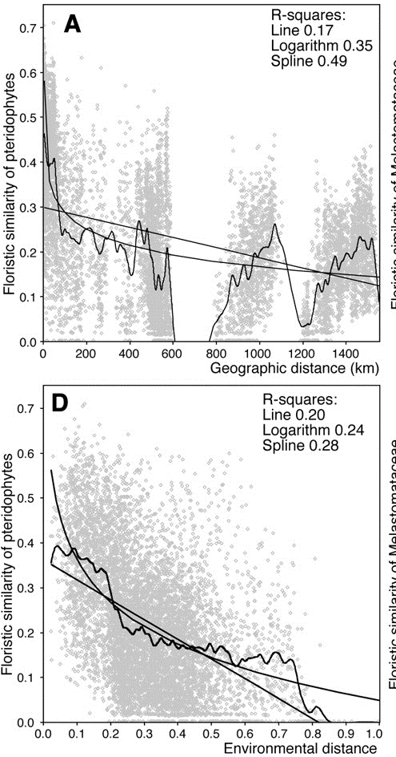
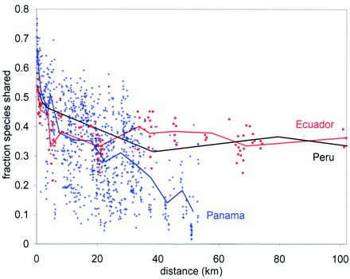
Beta diversity in tropical forests
Condit et al. 2001 Science
Tuomisto et al. 2003 Science

Slide 23
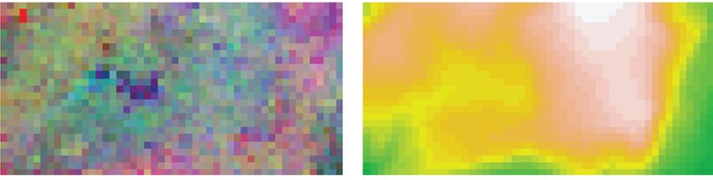
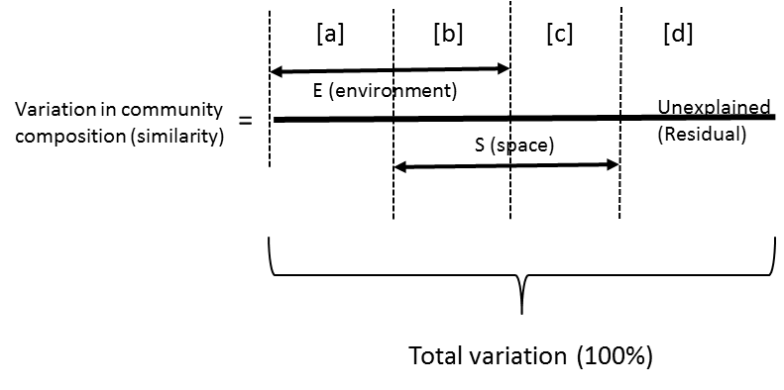
Partitioning the variation of β-diversity
(Legendre, Borcard, Peres-Neto, et al).
β-diversity structure
Spatial/Environmental structure

Slide 24
0.6
0.4
0.2
0.0
Variation explained
[E|S]
Environment
[E+S]
Total Explained
[S|E]
Space
[E with S]
Component
Cottenie 2005, Ecology Letters

Slide 25
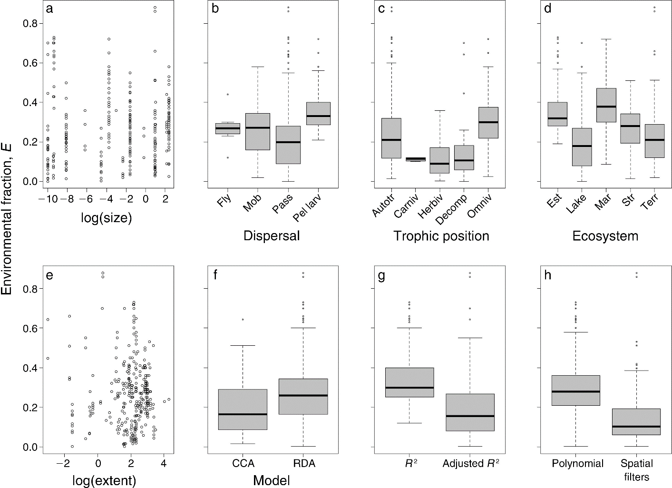
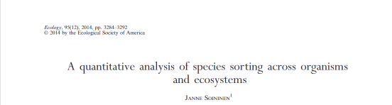

Slide 26
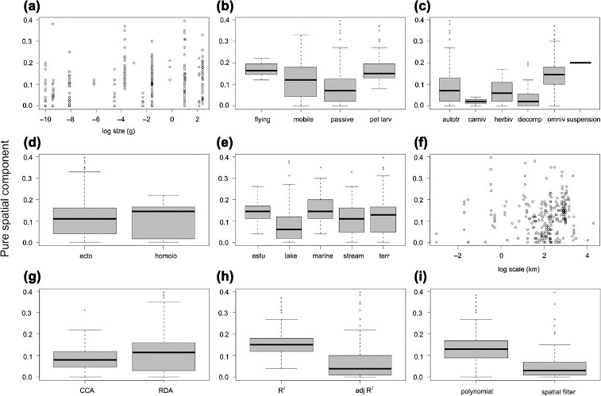


Slide 27
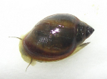
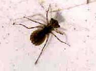
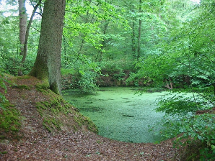
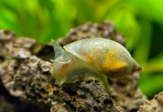
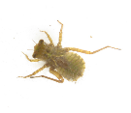
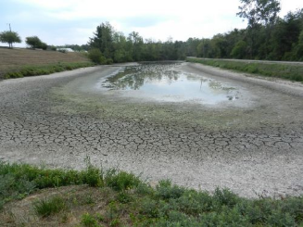
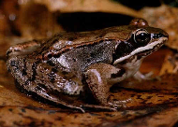

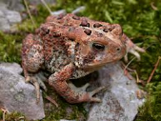


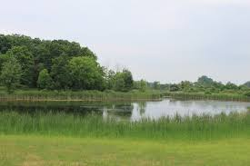
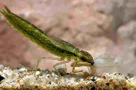
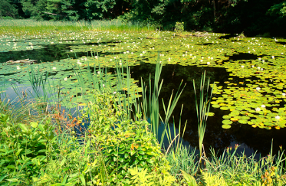
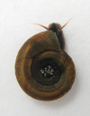
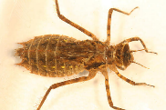
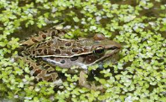
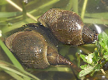

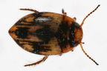
Small Freshwater Ponds—Niche is best
1
0.75
0.5
0.25
0
1
0.75
0.5
0.25
0
Compositional Similarity (Jaccard’s)
Compositional Similarity (Jaccard’s)
0 50 100 150 200 250 300 350 400 450
0 0.1 0.2 0.3 0.4 0.5 0.6 0.7 0.8 0.9 1.0
Spatial Distance (m)
Environmental Distance

Slide 28
Patterns on BCI and Small Ponds are at the extremes
….Are they structured by different processes??
Environment (≈ niche)
BCI
Space (≈ dispersal)
Ponds
Residuals (≈ drift + unmeasured)
Cottenie et al. 2005
Leibold & Chase 2017
Variation partitioning analysis
Notes:
But actually most studied communities spanning different ecosystems and regions are in the middle, with a tendency for niche processes to be more important than spatial processes (not related to the environment).

Slide 29
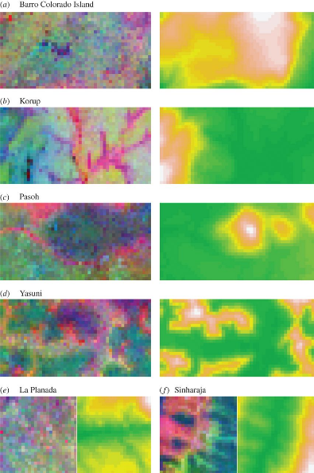
Even in Tropical Forests BCI is Unusual
Environment (≈ niche)
BCI
Space (≈ dispersal)
Residuals (≈ drift + unmeasured)
Baldeck et al. 2013 Proc. Roy Soc.

Slide 30
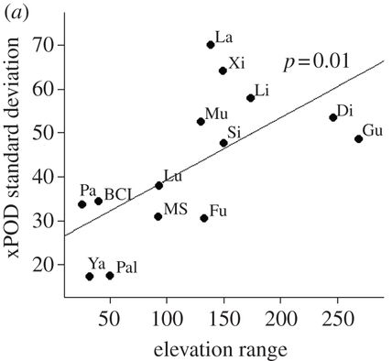
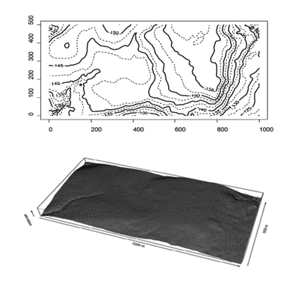
Niche segregation more likely to occur in more heterogeneous environments
Brown et al. 2013 Proc Roy Soc.

Slide 31
A lot of unexplained variation—drift (?), unmeasured?
Environment (≈ niche)
Space (≈ dispersal)
Residuals (≈ drift + unmeasured)
‘Unexplained variation’
Leibold and Chase 2017

Slide 32
When/Where is Ecological Drift More Likely to be Important?
Smaller population sizes/habitats.
2. Larger species pools
3. More benign environmental conditions…
….Less ‘Niche Selection’
4. Less heterogeneity
5. Lower rates of dispersal

Slide 33
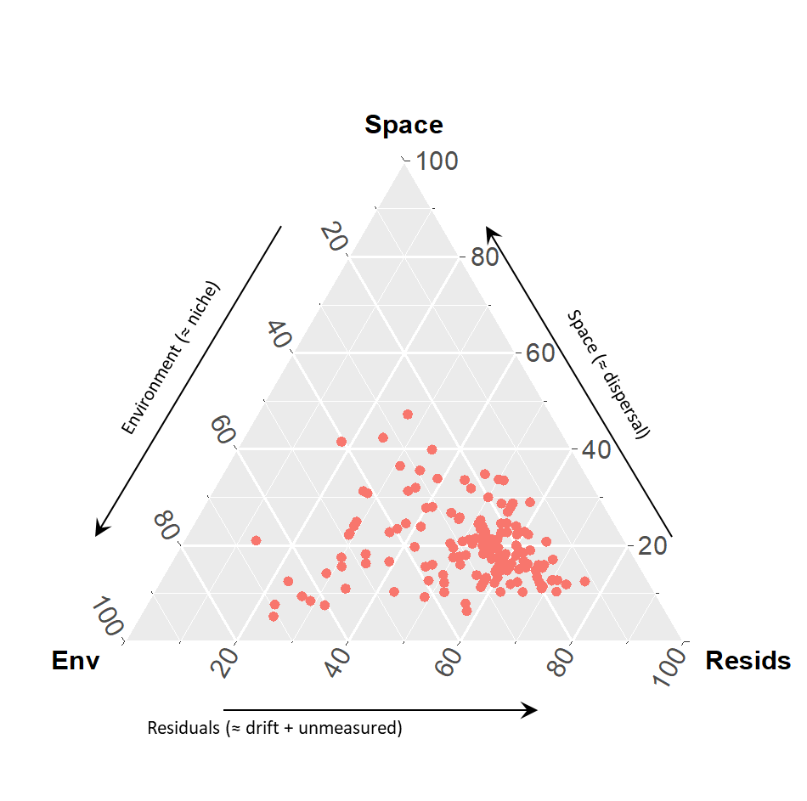
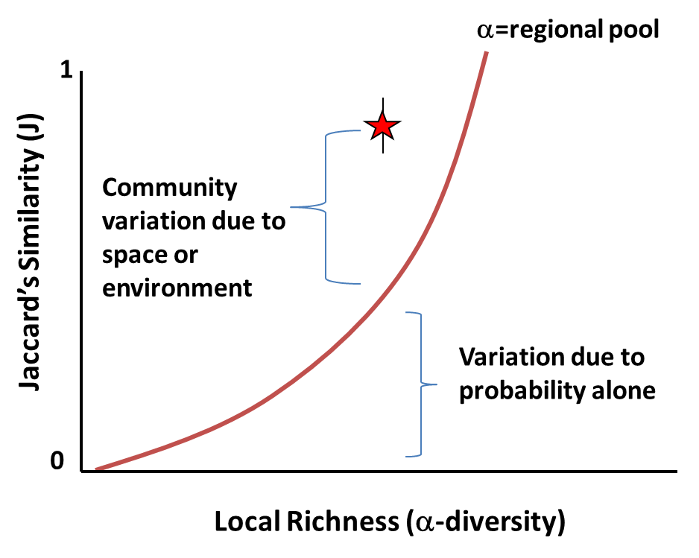
To test the theory appropriately…
… need null models to partition residuals
Chase et al. 2011 Ecosphere

Slide 34
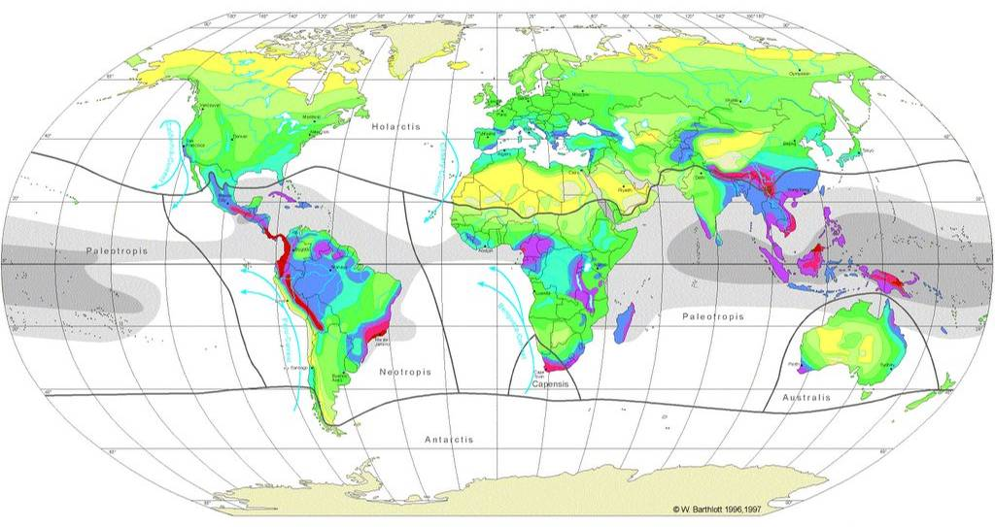
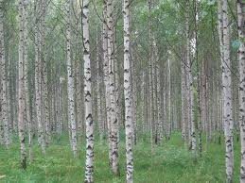


Is Neutral Theory More Prevalent in the Tropics??

Slide 35





Using the null model to infer process
Gentry’s O.1 ha forest transects
Species are more ‘aggregated’ than expected, and this appears to be similar across biogeographic regions
Kraft, Comita, Chase et al. 2011 Science

Slide 36






Using the null model to partition environment versus space
There are other ‘niche-y’ reasons these patterns could emerge
Unmeasured environmental variation
Frequency Dependence at the Regional Scale
-Connell-Janzen and related effects
-Priority Effects Multiple Stable Equilibria
‘Other’ spatial/metacommunity processes
Worse—these could simply be artefacts of ‘scale-dependence’
Bolivia Missouri
Myers, Chase et al. 2013 Ecology Letters

Slide 37

Is the null model enough to fix the sample biases? Unfortunately…. No
Small plot➔
Lower Heterogeneity
Large plot➔Higher Heterogeneity
Environment
Residuals, Space
Environment
Residuals, Space

Slide 38



Slide 39

Viana and Chase 2019
10.5281/zenodo.1484091

Slide 40
Scale→Community Assembly (Synthesis v. 2)
Environment
Dispersal
Environment (≈ niche)
Environment (≈ niche)
Fishless permanent ponds
Space (≈ dispersal)
Space (≈ dispersal)
BCI
All ponds
Permanent ponds
Residuals (≈ drift + unmeasured)
Residuals (≈ drift + unmeasured)
Viana and Chase unpublished

Slide 41



Comparing ponds vs. BCI: Metacommunity Scale Mismatch
~10,000-500,000 individuals
~250,000 individuals
~390,000,000 individuals
~10,000,000-500,000,000 individuals
Fricker et al. 2012, Remote Sens, 4(6))

Slide 42
Habitat Associations are Stronger at Larger Scales on BCI
Tabebuia guayacan
Jacaranda copaia
Oenocarpus mapora
Attalea butyracea
Garzon-Lopez et al. 2014. J. Veg Sci

Slide 43
Questions

Slide 44


Bending the Curve
Post-2020 Global Biodiversity Framework
EU Goals and Targets:
protect at least 30% by 2030
restore 3 billion hectares
halt species extinctions caused by humans
address unsustainable agriculture, forestry and fisheries
tackle drivers of biodiversity loss
strengthen links between biodiversity and climate action

Slide 45

Break/Read (20 minutes)
https://onlinelibrary.wiley.com/doi/full/10.1002/ece3.8097
Is Neutral Theory Useful for Conservation?
Discuss: Breakout groups (10 minutes)
Discuss: Full group (10 minutes)

Slide 46
Lecture 10—Metacommunities

Slide 47
The R* Principle
A
Growth rate dN/Ndt
B
R*_{B}
R*_{A}
[R]
Two species together…the species with the lowest R* always wins
….when there is only one limiting resource, and the system is at equilibrium
…But, then how do species coexist??

Slide 48
Fundamental Principle of Coexistence: Linked trade-offs
Resource Competition
Apparent Competition
Coexist
Resource A
Predator A
Coexist
Resource B
Predator B
Keystone Predation
Disturbance/variation
Predator
Disturbance/ E nv. variation
Coexist
Coexist
Resource
Resource
Chase and Leibold 2003

Slide 49
Species can’t be too similar……
….but, they also can’t be too different
~Chesson’s (2000) General Theory of Coexistence
Coexistence depends on the ratios of:
→Stabilizing Mechanisms (Can’t be too similar)
→Equalizing Mechanisms (Can’t be too different)
Possible Coexistence
Possible Coexistence
Resource A
Resource B

Slide 50
Other factors that influence coexistence:
Time—Intrinsic and extrinsic
Space—Heterogeneity, dispersal
Simple view:
-1 resource=1 species
-2 resources=2 species
-N resources=N species
But often:
-N Resources << N species
Interactions between them
Frequency Dependence, colonization competition
Space, time and predation
--Janzen-Connell effects
Other limiting factors:
Disturbance/Stress
Apparent Competition via Shared Predators
Keystone Predation

Slide 51

Trade-offs in Time
Chesson and Huntly 1997, American Naturalist

Slide 52


Trade-offs in time

Slide 53
Even classic coexistence stories had a spatial component
Gause 1934

Slide 54

Adding Space:
Spatial processes influence Coexistence → metacommunity
Habitat heterogeneity → Species Sorting

Slide 55

Many Species, 2 resources (with spatial heterogeneity)
Resource Supply
Tilman and Pacala 1993

Slide 56

“MacArthur’s Paradox” and the Metacommunity
Habitat heterogeneity
Dispersal
Original Resource Ratio Model
Basis for Niche Theory
Theory of Island Biogeography:
Basis for Neutral Theory

Slide 57
Metacommunities: The role of space
(Heterogeneity, dispersal)

Slide 58









Leibold et al. 2004, Ecology Letters

Slide 59

Logue et al. 2011, Trends Ecol. Evol.

Slide 60

Ovaskainen et al. 2019. Ecography

Slide 61

Can we make a better metacommunity model?
For theory and data analyses?

Slide 62

Processes instead of Paradigms
Thompson et al. 2020 Ecology Letters

Slide 63

The 4 paradigms only represent a small amount of the possible space

Slide 64

The 4 paradigms only represent a small amount of the possible space

Slide 65

The processes interact

Slide 66

Other response variables: Stability

Slide 67

Other response variables: Ecosystem Function

Slide 68


Empirical tests?

Slide 69

What we sample is usually not even close to enough!

Slide 70


Slide 71
Questions

Slide 72

install.packages(c('shiny', 'shinyBS', 'shinyWidgets','tidyverse','ggExtra','viridis','cowplot'))
shiny::runGitHub("plthompson/Meta_com_framework", subdir = "meta_com_shiny")
Break and Explore Shiny program: 15 minutes
Breakout Groups: What questions would you ask with this model? (15 minutes)
Group Discussion: (15 minutes)

